Slide 1
UDS service
Control dtc setting 0x85

Slide 2
Introduction to UDS Protocol
The UDS Protocol is the latest automotive vehicle diagnostic protocol used to diagnose any vehicle all over the world.
This protocol is defined in ISO-14229 standard
some diagnostic programs which can run periodically inside the processor
The UDS protocol specification is defined in 8 different sub-standards of ISO 14229
Basically, it is used in the automotive field for vehicle diagnostic, ECU new software flashing, etc.

Slide 3
Why Diagnostic need in a vehicle?
We may wish to see data stored within the system – such as Trouble codes – or some form of the identifications.
We may wish to see live data – such as the engine or vehicle speed.
We may want to transfer a large amount of data – for example re-flashing a module (ECU).
We may wish to take direct control of module I/O – for an example disabling individual cylinders to identify the fault.
We may wish to run specific routines already in a module – such as some form of self-calibration.
We may wish to apply security locks to certain services or to allow the normal function of a system to be disturbed to vary degrees.

Slide 4
The UDS protocol services are using the 5th (Session layer) and 7th (Application) layer of the OSI model while the CAN protocol works on the 1st (Physical) and 2nd (Data Link layer) layer of the OSI model.
UDS Protocol Physical and Functional Addressing
A functional request is a broadcast-type message which will be sent to all ECUs
The Physical UDS-requests are only sent to a single ECU

Slide 5
UDS Protocol Frame Format
Diagnostic request Frame (With/without Sub-function-ID).
Diagnostic Response Frame.
Positive Response.
Negative Response.

Slide 6
UDS Protocol Request Frame Format:
Whenever the client wants to request anything from the server then the tester will send this request the frame to get the response from the server on the CAN data field. This frame had consisted of 3 fields:
Service ID.
Sub-Function ID (optional: not exist for some diag. services).
Data bytes.

Slide 7
UDS Protocol Response Frame Format:
Positive response
Whenever the tester will request to the server if it is correct and the server has been executed the request successfully, then it will send the response message concerning this request by adding 0x40 to the respective service ID for reference. Positive response 1st byte should be Request Service ID + 0x40.

Slide 8
Negative response
If the client did not request in a proper frame format or the server is not able to execute the request due to the internal problem, then it will send a negative response to the client.
Negative response 1st byte should be 0x7F.
Negative response 2nd byte should be Service ID.
Negative response 3rd byte should be Response Code.

Slide 9
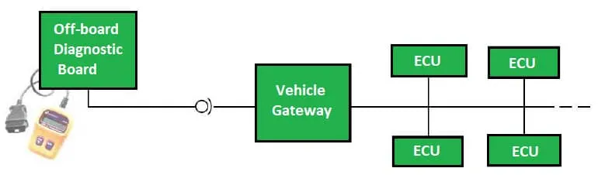
OBD-II Gateway with Vehicle Network

Slide 10
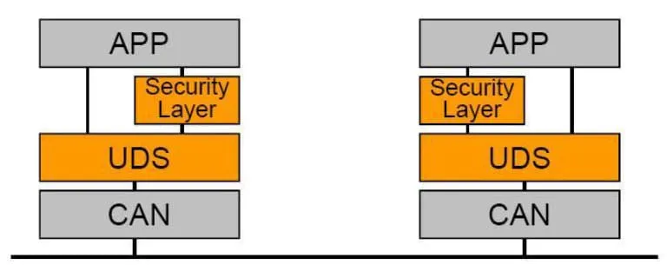
UDS is independent of lower-layer protocols.
(UDS) on top at an application layer-level, generic network layer services at an intermediate level and employing the means of the controller area networks (CAN) or another communication bus protocol (like LIN, FlexRay or Ethernet) for the data link and physical layers’ levels, at lower stages.

Slide 11
Functions of Diagnostic Services In UDS Protocol
Diagnostic and communication management.
Data Transmission.
Stored Data Transmission.
Input/Output Control.
Remote activation of routine.
Upload/Download.

Slide 12
Diagnostic and communication management:
Diagnostic Session Control (0x10)
ECU Reset (0x11)
Security Access (0x27)
Communication Control (0x28)
Tester Present (0x3E)
Access Timing Parameter (0x83)
Secure Data Transmission (0x84)
Control DTC setting (0x85)
Response To Event (0x86)
Link Control (0x87)

Slide 13
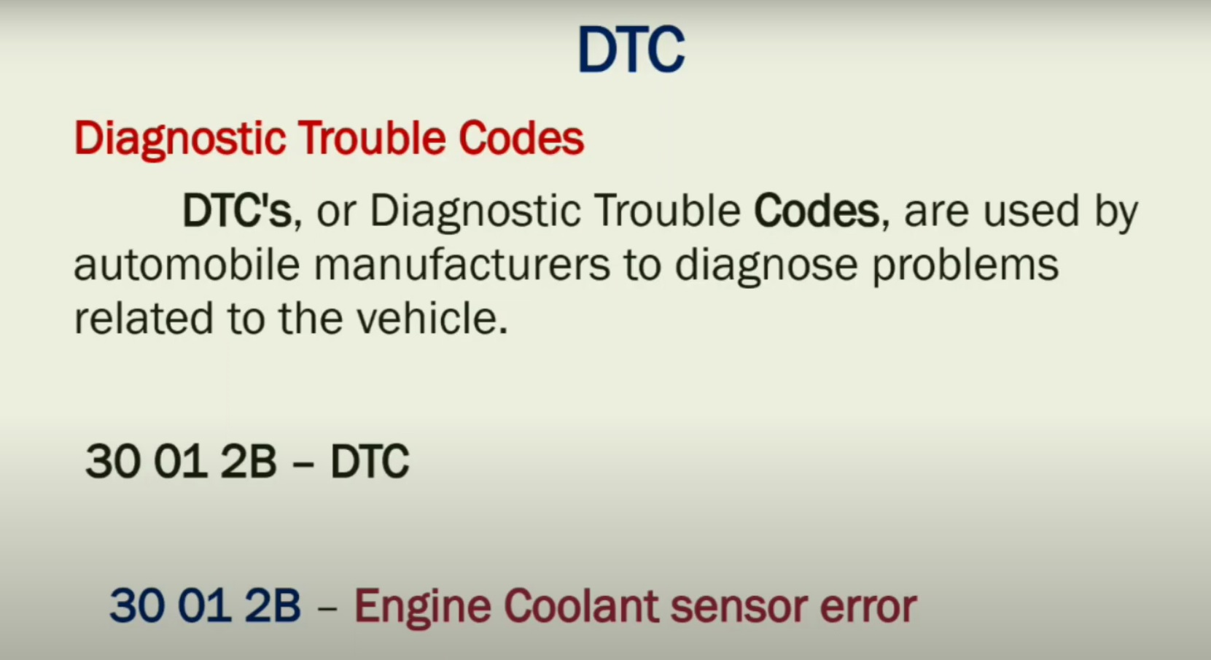

Slide 14
Control DTC setting (0x85): UDS Protocol
The ControlDTCSetting service shall be used by a client to stop or resume the setting of diagnostic trouble codes (DTCs) in the ECU. It is used to Activate / Deactivate storing of errors into error memory. Mostly, it is used during flash programming and development.
This would be very helpful when the client knows the issue in the vehicle but is trying to find the root cause by doing some additional experiments.

Slide 15
When the client request the Server to turn OFF, the Server receives the request and temporarily turns off this feature and the server holds the current value and suspends the new value.
Later, When the client requests the server to turn ON, then the server will update with the new value.

Slide 16
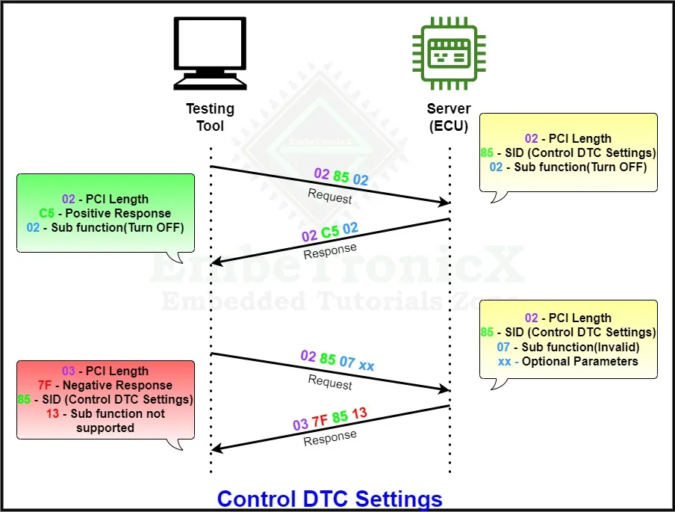
SBF-ID | SBF Name
0x01 | DTC On
0x02 | DTC Off

